Slide 1
The art of defensive programming
Joylynn Kirui
@joylynn_kirui

Slide 2


TALK OUTLINE
WHO I AM
WHAT I AM TALKING ABOUT
WHY I'M TALKING ABOUT IT
HOW WE CAN WORK WITH IT
DEMO / QnA
THANKS

Slide 3


SPEAKER’S PROFILE
Joylynn Kirui is an infosec evangelist who believes in empowering developers and users in general on security best practices. She has vast experience in web and mobile app security testing, DevSecOps and GSM security having previously worked in the telco industry for 6 years. She has a passion for mentorship and training students and empowering them. She is among the Top 50 Women in Cyber Security Africa 2020 finalists and Woman Hacker of the year Africa 2020. She is a Senior Cloud Security Advocate at Microsoft; Based in Nakuru, Kenya.

Slide 4
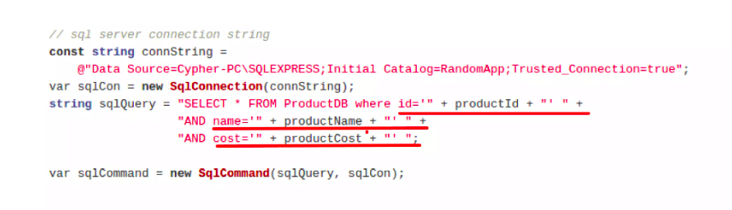
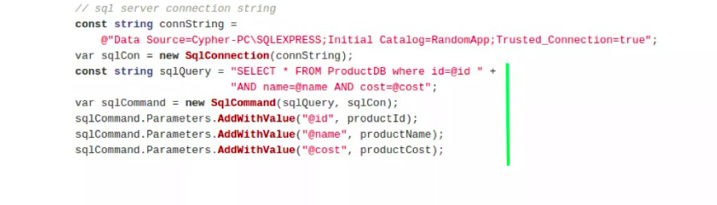
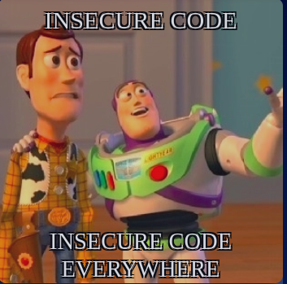

Bugs n Hacks : A CODE STORY
Spot the problem with the code
With every commit, the threat landscape increases. One single vulnerability is all a hacker needs. Vulnerabilities have multiple sources, and you must have a plan for securing each potential risk vector and identify vulnerabilities early. The later they are identified, the more expensive and dangerous remediation is. Join me to discuss how you can practically deploy defensive coding techniques to identify vulnerabilities as early as possible.

Slide 5
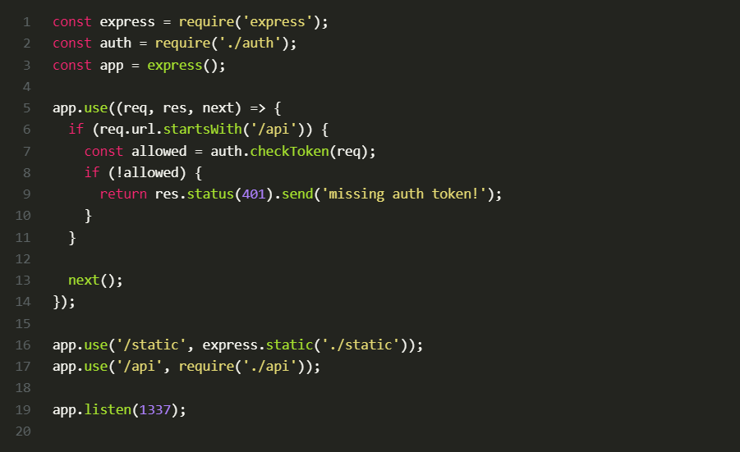
Can you spot the vulnerability?
Source: Sonar
Notes:
The routing of the express framework is case-insensitive by default. This means that requesting /api/users/ and /API/users will have the same outcome. In contrast, the authentication middleware that is supposed to protect the /api endpoint only checks for a valid token when the route starts with /api. Since this check is case sensitive, it can be bypassed by accessing /API because express will still route it to the correct API handler while auth tokens are not validated.

Slide 6
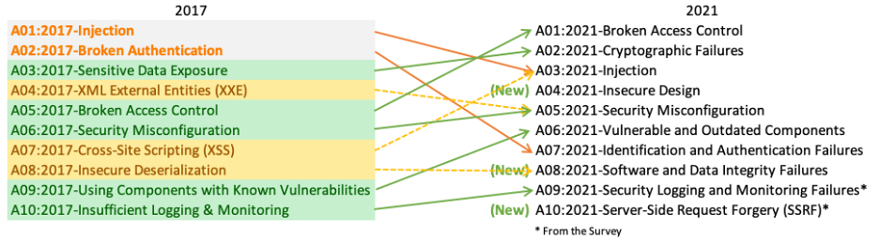
Top 10 Web Application Security Risks
Example of Broken Access Control:
https://example.com/app/getappInfo https://example.com/app/admin_getappInfo
Source: owasp.org
Notes:
A01: Broken Access Control: Access control enforces policy such that users cannot act outside of their intended permissions. Failures typically lead to unauthorized information disclosure, modification, or destruction of all data or performing a business function outside the user's limits. Common access control vulnerabilities include:
Violation of the principle of least privilege or deny by default, where access should only be granted for particular capabilities, roles, or users, but is available to anyone.
Bypassing access control checks by modifying the URL (parameter tampering or force browsing), internal application state, or the HTML page, or by using an attack tool modifying API requests.
Permitting viewing or editing someone else's account, by providing its unique identifier (insecure direct object references)
Accessing API with missing access controls for POST, PUT and DELETE.
Elevation of privilege. Acting as a user without being logged in or acting as an admin when logged in as a user.
Metadata manipulation, such as replaying or tampering with a JSON Web Token (JWT) access control token, or a cookie or hidden field manipulated to elevate privileges or abusing JWT invalidation.
CORS misconfiguration allows API access from unauthorized/untrusted origins.
Force browsing to authenticated pages as an unauthenticated user or to privileged pages as a standard user.
The example given: An attacker simply forces browses to target URLs. Admin rights are required for access to the admin page. If an unauthenticated user can access either page, it's a flaw. If a non-admin can access the admin page, this is a flaw.

Slide 7
STRIDE model
Category | Description
Spoofing | Involves illegally accessing and then using another user's authentication information, such as username and password
Tampering | Involves the malicious modification of data. Examples include unauthorized changes made to persistent data, such as that held in a database, and the alteration of data as it flows between two computers over an open network, such as the Internet
Repudiation | Associated with users who deny performing an action without other parties having any way to prove otherwise
Information Disclosure | Involves the exposure of information to individuals who are not supposed to have access to it
Denial of Service | Denial of service (DoS) attacks deny service to valid users
Elevation of Privilege | An unprivileged user gains privileged access and thereby has sufficient access to compromise or destroy the entire system. Elevation of privilege threats include those situations in which an attacker has effectively penetrated all system defenses and become part of the trusted system itself, a dangerous situation indeed
Notes:
Repudiation example - for example, a user performs an illegal operation in a system that lacks the ability to trace the prohibited operations. Non-Repudiation refers to the ability of a system to counter repudiation threats. For example, a user who purchases an item might have to sign for the item upon receipt. The vendor can then use the signed receipt as evidence that the user did receive the package
Information disclosure example - for example, the ability of users to read a file that they were not granted access to, or the ability of an intruder to read data in transit between two computers
DoS example - for example, by making a Web server temporarily unavailable or unusable. You must protect against certain types of DoS threats simply to improve system availability and reliability

Slide 8


DEFENSIVE PROGRAMMING EXPLAINED
Defensive programming is a form of defensive-design intended to develop programs that are capable of detecting potential security abnormalities and make predetermined responses. It ensures the continuing function of a piece of software under unforeseen circumstances - WIKIPEDIA
"Anything that can go wrong will go wrong, and at the worst possible time."
~ Murphy's' Law
Notes:
Defensive programming is like defensive driving in that it is the creation of code that is meant to deal with any possible scenario thrown at it. Programmers typically try to determine ways in which users are likely to enter input or try to use software that may be outside of expected parameters. The use of defensive programming is built upon the foundation of the code itself, which is designed to be able to handle strange input without crashing or encountering an error event.
Murphys law comes into play as you walk in the jungle as a team/platoon you have to be prepared for anything

Slide 9

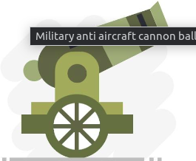
IMPORTANCE OF DEFENSIVE PROGRAMMING
Securing your internal software from malicious input
Increase Accuracy of the system
Reducing problems from user interactions
Make it easier to read & understand code
Malicious Actors only need to be lucky once , but defenders
have to be lucky all the time ~ a wise person called Joylynn , probably
Notes:
1 . In a world where software supply chain attacks are on the rise ,developers are our first line of defence , their code that manages our critical systems must adopt to murphy's law
2. Adopting the defensive programming helps stem out error and bugs to ensure the business logic of the code applies accurately to the end result expected
3 . Programming with Bugs in mind help increase and cater for the end users experience sorting such bugs increases the security and UX for and end user

Slide 10

WHAT DEFENSIVE PROGRAMMING PROTECTS Against
Incorrect/ invalid inputs – make sure you validate inputs using range checkers, length checkers ,non-null checkers
Incorrect /Invalid Operations – ensure unit tests to confirm the logic works as it should, log your code as it works
Against System Issues – Add invariant checkers in your operations, handle exceptions in code
Against Other Parties – Policy of Trust but verify

Slide 11

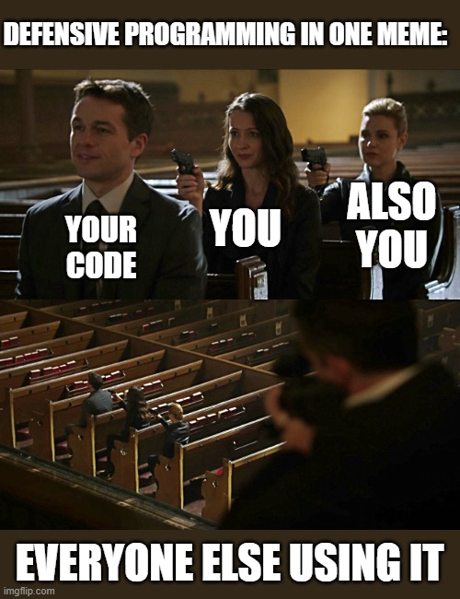
PRINCIPLES OF Defensive programming
Assume errors and unexpected situations will occur
Test thoroughly and keep code up to date with security patches.
Use Consistent error handling and validate input
Use Clear and Concise Code
Notes:
Assume errors and unexpected situations will occur. -Assume the worst. When writing code, assume that the user will input invalid data, the system will be under heavy load, or something else will go wrong
Use consistent error handling: Use consistent error handling throughout your code to ensure that errors are handled appropriately and consistently.
Use clear and concise code. Avoid complex or obscure code that can introduce unnecessary complexity or security vulnerabilities.

Slide 12

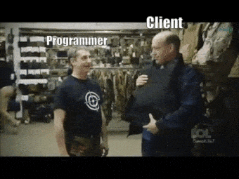
Assume the Unexpected Happens
As your code goes into the real world expect that the end user will add their own things and some malicious actors will try to bypass your systems as you code , code with bugs and malicious actors in mind and how your code can cater for such scenarios

Slide 13
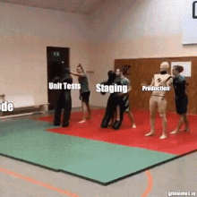
Perform Comprehensive TESTING
Unit Testing: Unit tests help catch bugs and ensure that each unit performs as intended
Security testing involves identifying vulnerabilities and weaknesses in the software's security mechanisms. Incorporating SCA , SAST and auditing your SBOM is imperative
Functional Testing: It involves validating the system's behaviour against the functional requirements and specifications from users' perspective
Notes:
Unit Testing: By breaking down the code into smaller units, such as functions or methods, and testing them independently, you can verify their correctness and functionality. Unit tests help catch bugs and ensure that each unit performs as intended
Security Testing to uncover cybersecurity threats that might not have been disclosed
Functional testing focuses on testing the overall functionality of the software from a user's perspective. It involves validating the system's behavior against the functional requirements and specifications

Slide 14
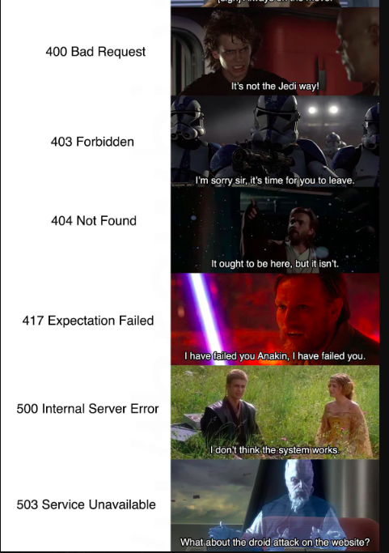
Use Consistent Error Handling and input validations
Always consider all possible errors a user can get and cate for them in a loop the rest cater for in an error sink
Assert when things should happen and also assert when things shouldn't happen
Report errors in the right manner via error codes and exceptions be concise with your error messages

Slide 15
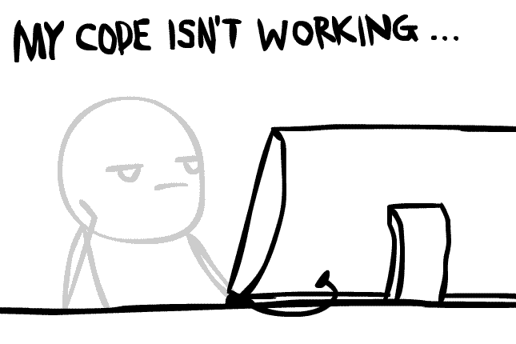
MAY THE CODE BE WITH YOU
Write consistent and certain code - Only accept valid inputs so your program behaves in the same manner every time
Your Code should fall under consistent and Predictable conditions with clear error messages
Write code that is predictable for instance do not allow execution of wrong input to avoid unforeseen irreversible side effects
Trust but verify - Don’t trust just any code always do code reviews

Slide 16


Demo Threat modeling using Microsoft Threat Modeling Tool
Notes:
Threat modeling using Microsoft Threat Modeling Tool

Slide 17
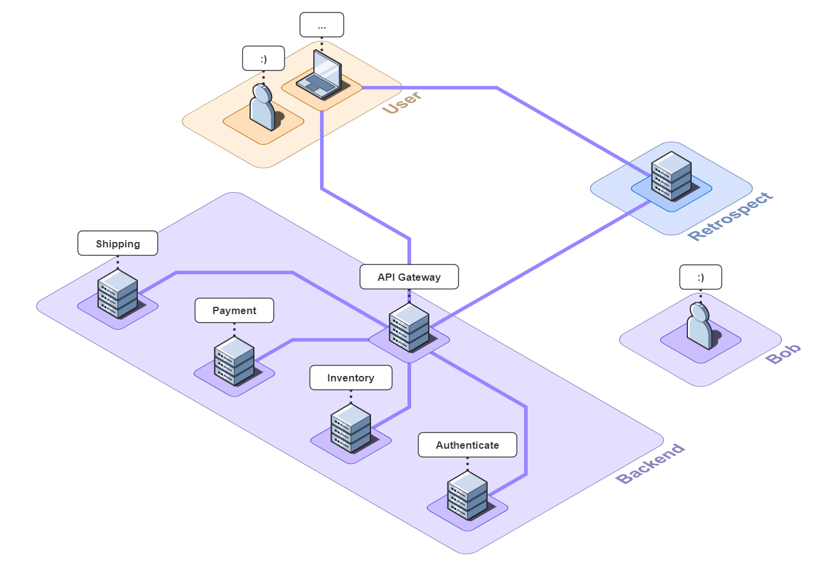
KEY TAKEAWAYS

Slide 18
Thank You

Slide 19


Slide 20


Slide 21





